Slide 1
Traffic Accident Severity Prediction
A Big Data Project for Improving Road Safety

Slide 2
Introduction
This presentation explores a predictive analysis project focused on traffic accident severity, utilizing big data techniques to enhance road safety. We will cover the project goals, dataset characteristics, and key findings derived from our data analysis.

Slide 3
01
Project Goal

Slide 4
Analyze traffic data for predictions
The project aims to utilize machine learning algorithms to analyze historical traffic accident data. By examining patterns, we will predict the severity of future accidents. This prediction helps authorities to implement measures to improve road safety based on data-driven insights.

Slide 5
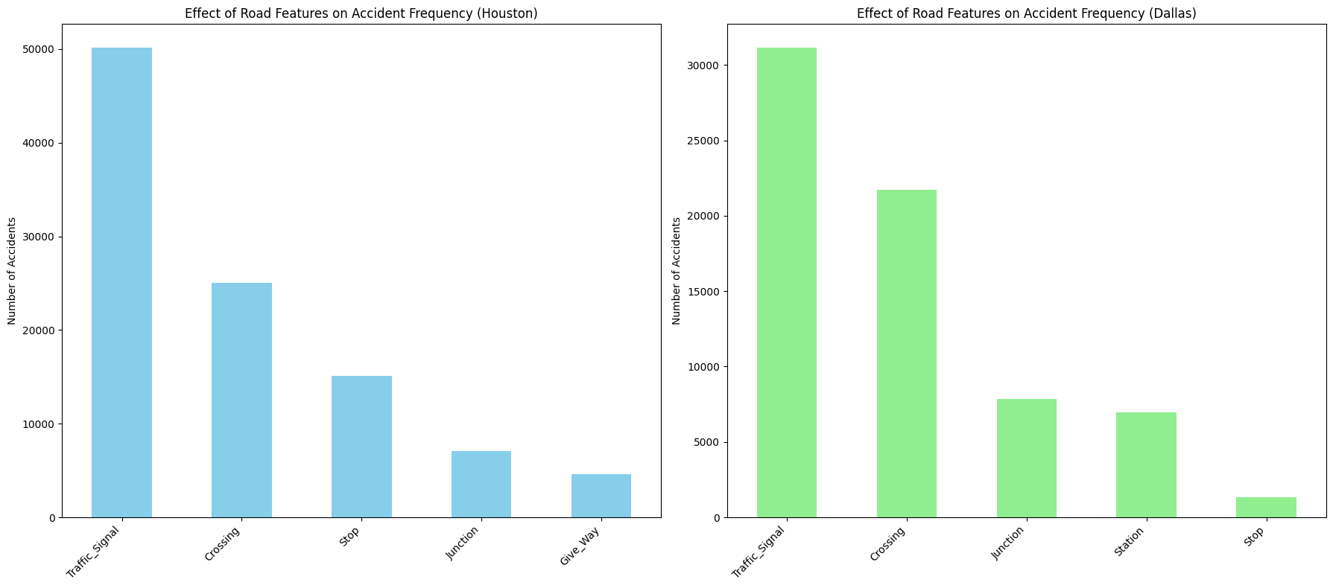
Identify patterns and trends
Through our analysis, we will uncover significant trends related to accident frequency and severity across different geographic areas. Understanding how factors such as weather conditions and road features impact accident rates enables leaders to prioritize interventions and enhancements in traffic management.

Slide 6
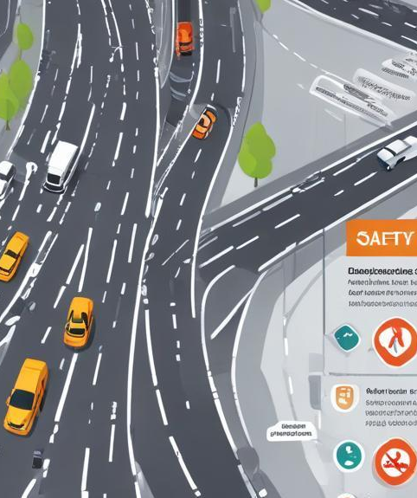
Provide insights for safety improvements
The analyses conducted will yield actionable insights for road safety stakeholders. By understanding the correlations between different factors, such as weather patterns and road infrastructure, authorities can make informed decisions about where to allocate resources for traffic safety improvements. This may include enhanced signage, improved lighting, and increased law enforcement presence in high-risk areas.

Slide 7
02
Dataset Overview

Slide 8
Data source and characteristics
The dataset utilized for this analysis is sourced from Kaggle, containing approximately 1,000,000 records across 46 columns. It offers a comprehensive view of traffic accidents, detailing various attributes that can be analyzed to predict severity. The large size of the dataset helps in ensuring statistically significant conclusions can be drawn from the analyses performed.

Slide 9
Key attributes of the dataset
Important attributes in the dataset include:
- Severity: This is the target variable
- Location: Geographic details
- Weather Conditions: This includes temperature, humidity, etc.
- Road Features: Details on traffic signals, pedestrian crossings, etc.

Slide 10

Sample data visualization
To enhance understanding of the dataset, visualizations are vital. A bar chart showing the distribution of accident severity can provide intuitive insights into how incidents are spread across different severity levels. Furthermore, a sample data table will offer a snapshot of critical attributes such as ID, severity level, and other related information, aiding in understanding the dataset's layout.

Slide 11
03
Project Overview

Slide 12
Project stages
The project consists of four sequential stages:
- Stage 1: Data ingestion and preprocessing
- Stage 2: Data preprocessing and Query execution
- Stage 3: Machine learning modeling
- Stage 4: Model evaluation and Results storage

Slide 13
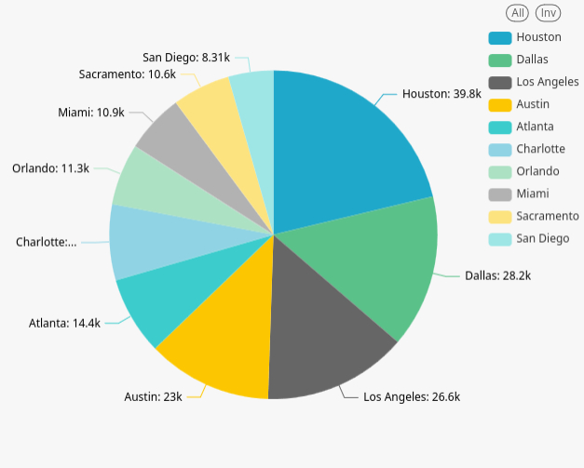
Achieved results

Slide 14

Conclusions
In summary, this project highlights the use of traffic accident data to predict severity levels effectively. The insights derived can significantly influence road safety policies and interventions. By focusing on key attributes and analyzing trends, we equip stakeholders with the knowledge needed to enhance public safety. Continuous monitoring and utilization of big data will be crucial in reducing accidents and improving overall traffic conditions.

Slide 15
Thank you!
Do you have any questions?
Please keep this slide for attribution

